Slide 1

SQL Stored Procedure
Date : 04-Aug-2017

Slide 2
Summary of Contents
Definition
Types
Summary or explanation
Sample examples
Live scenarios
Walk through
Options
System catalogue
Authority
Changes
Error Handling
Benefits

Slide 3
Definition – Stored Procedure
A stored procedure is an ordinary program that can be called by an application with an SQL CALL statement. The stored procedure can be called locally or remotely.
A remote stored procedure provides the most advantages
      It reduces traffic across the communication line.
      It splits the application logic and encourages an even distribution of the computational workload.
      It provides an easy way to call a remote program.
      Security mechanism.

Slide 4
SQL Stored Procedure Types
Stored procedures can be divided into two categories:
SQL stored procedures
External stored procedures

Slide 5
SQL Stored Procedure…
SQL stored procedures are written in the SQL language, which makes it easier to port stored procedures from other database management systems (DBMS) to the IBM i server and from the IBM i server to other DBMS..
Its like simple SQL statements…
Front End Application (java based) want to interact with back end DB2 data base and get the required information.
Example:
Insured member logged into portal and view his history claims. He will enter his details and hit enter..
Web App/
Portal
Source DB
Request Translator
Web services

Slide 6
External Stored Procedure…
An external stored procedure is written by the user in one of the programming languages on the IBM i server.
Needed components
      Program/Service Program
      Procedure
    Linkage process
Tell the procedure to call the compile program whenever the procedure is invoked.
Program/ Compile – Create *PGM
Procedure creation

Slide 7
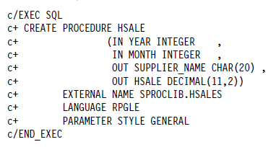
Sample Stored Procedure…
    Linkage process
In bound– year/Month
Out bound–
supplier Name/Sale Value
Program
(HSALES)
HSALE procedure

Slide 8
Registering Stored Procedure…
    Any process/procedure needs to be registered
    DECLARE PROCEDURE or the CREATE PROCEDURE statement
    Declare Procedure Create Procedure
    1.Statement is not frequently used 1. One time process
    2.Temporary registration of stored 2.blue print in system tables
    procedure 3. Need to drop if any changes in procedure
3. It is not stored in System tables-
SYSROUTINES and SYSPARMS.
    Linkage process
    Ex: Java based stored procedures

Slide 9

Create Procedure
The CREATE PROCEDURE statement can be used to create any of the two types of stored procedures.
It can be called from any interface that supports the SQL CALL statement.
Control characteristics that affect the way that the stored procedure is identified in DB2 Universal Database for iSeries or its behavior.
Specific name to each procedure for identification

Slide 10
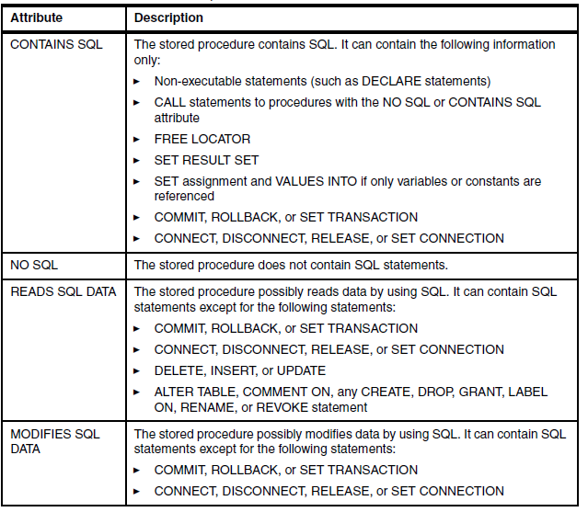
Syntax - Create Procedure

Slide 11
SET OPTION
The SET OPTION clause gives you more control over how the SQL stored procedures are
created. You can control the following options with SET OPTION:
Option | Details
OUTPUT | Specifies whether a listing file is required. If it is set to *PRINT, it generates two listing spool files: one file for the intermediate C code and another file for the corresponding precompiled C code.
DBGVIEW | Controls the level of debug information that is contained in the program object. The default is none, but you can set *STMT, *LIST, or *SOURCE values. *STMT allows the compiled module object to be debugged by using program statement numbers and symbolic identifiers. *LIST generates the listing view for debugging the compiled module object. You can use *SOURCE to debug the generated program or module at the SQL statement level.
TGTRLS | Defines the target release of the operating system in which you intend to use the stored procedure
DATFMT | Specifies the format for dates
DATSEP | Specifies the date separator.
TIMFMT | Specifies the format for times.
TIMSEP | Specifies the time separator

Slide 12
SET OPTION
Option | Details
DECMPT | Specifies the decimal point value (can be *POINT, *COMMA, *SYSVAL, or *JOB).
SRTSEC | Specifies the sort sequence table to be used for string comparisons in SQL statements
LANGID | Specifies the language identifier to be used when SRTSEQ(*LANGIDUNQ) or SRTSEQ(*LANGIDSHR) is specified
ALWCPYDTA | Specifies whether a copy of the data can be used in a SELECT statement. The possible values are *YES, *NO, and *OPTIMIZE (default). It influences the optimizer access plan for SELECT statements
ALWBLK | Specifies whether the database manager can use record blocking and the extent to which blocking can be used for read-only cursors
DLYPRP | Specifies whether the dynamic statement validation for a PREPARE statement is delayed until an OPEN, EXECUTE or DESCRIBE statement is run. Delaying validation improves performance by eliminating redundant validation.
USRPRF | Specifies the user profile that is used when the compiled program object and SQL package object are run, including the authority that the program object or SQL package has for each object in static SQL statements. The profile of either the owner or the user is used to control access to objects
DYNUSRPRF | Specifies the user profile that is used for dynamic SQL statements

Slide 13
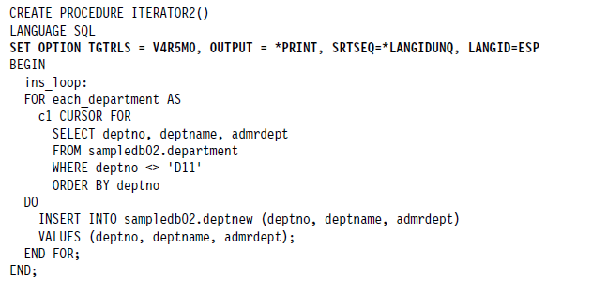
Sample Example

Slide 14
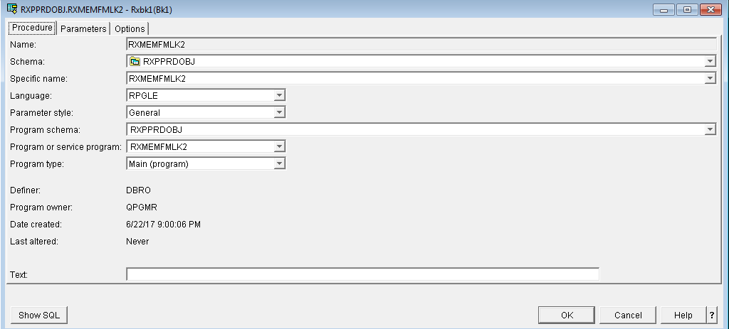
Setup
CREATE PROCEDURE &LIB/RXMEMFMLK2 (
IN IMEMBERID CHAR(18) ,
IN IDOB CHAR(8) ,
IN ICARRIERID CHAR(9) ,
IN IACCOUNTID CHAR(15) ,
IN IGROUPID CHAR(15) ,
IN IFMIDSCOPE CHAR(1) ,
IN IACTIVEIND CHAR(1) )
DYNAMIC RESULT SETS 1
LANGUAGE RPGLE
SPECIFIC RXMEMFMLK2
NOT DETERMINISTIC READS SQL DATA
CALLED ON NULL INPUT
EXTERNAL NAME &LIB/RXMEMFMLK2
PARAMETER STYLE GENERAL

Slide 15
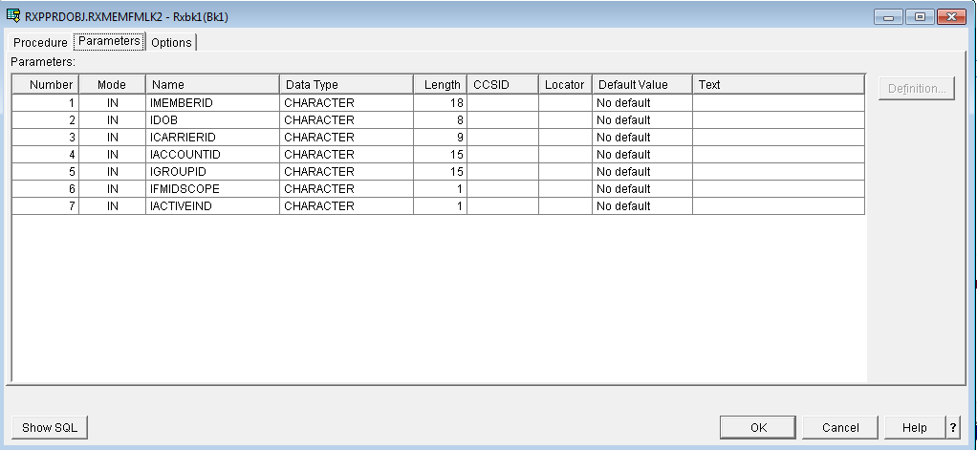
Setup

Slide 16
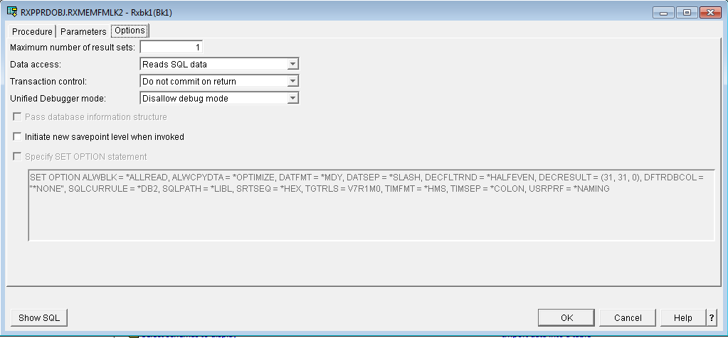
Setup

Slide 17
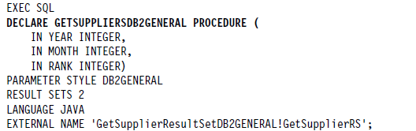
Declare Procedure
DECLARE PROCEDURE is a kind of temporal procedure definition in which the stored procedure is declared in a program. Originally, you were only able to embed it in an application program as a static SQL statement.
However, starting in V5R1 (and we advise that you look for the latest iSeries/IBM i Access Open Database Connectivity (ODBC) driver available), DECLARE PROCEDURE can be used as a dynamic SQL statement in an ODBC program.

Slide 18
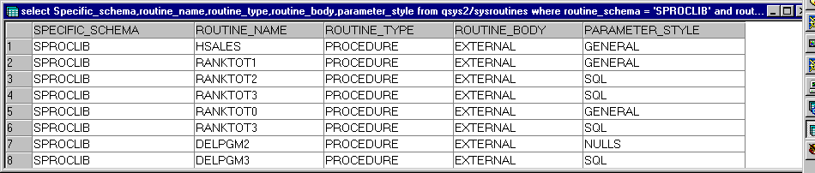
System Catalogs
    SYSROUTINES catalog
    select * from qsys2.sysroutines;
    The SYSROUTINES catalog contains information about both stored procedures and user-defined functions (UDFs). You can use the SYSPROCS catalog view to work with stored procedures. The SYSFUNCS catalog view contains the information for the UDFs.
    SYSPARMS catalog

Slide 19
Deleting or replacing stored procedures
The CREATE PROCEDURE statement does not have a replace option. For this reason, if you want to re-create or delete an existing procedure, use the DROP PROCEDURE statement.
CREATE OR REPLACE PROCEDURE rxpprdobj/RXMEMFMLK2
Real time Example – scenarios where we need to recreate
Deployment archival process of previous program would archive the procedure.
SBMJOB CMD(RUNSQL SQL('CREATE OR REPLACE PROCEDURE rxpprdobj/RXMEMFMLK2
( IN IMEMBERID CHAR(18) ,
IN IDOB CHAR(8) ,
IN ICARRIERID CHAR(9) ,
IN IACCOUNTID CHAR(15) ,
IN IGROUPID CHAR(15) ,
IN IFMIDSCOPE CHAR(1),
IN IACTIVEIND CHAR(1) )
DYNAMIC RESULT SETS 1
LANGUAGE RPGLE
SPECIFIC RXMEMFMLK2
NOT DETERMINISTIC READS SQL DATA
CALLED ON NULL INPUT EXTERNAL NAME rxpprdobj/RXMEMFMLK2
PARAMETER STYLE GENERAL') COMMIT(*NONE)) JOB(RXMEMFMLK2) JOBD(CLMPSITOOL/QCLMJOBD)
JOBQ(TWSMULTI) USER(RXOBJOWN)

Slide 20
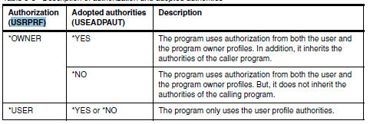
Authorization and adopted authority
Authority is always a criteria/ control mechanism to maintain the rights and safe guard the system
    In general USRPRF(*OWNER) - creation

Slide 21
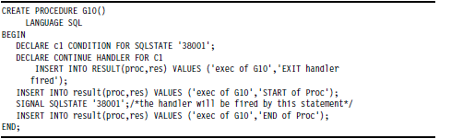
Error Handling
Database error reporting strategy
      SQLCODE and SQLSTATE
      Code programmatically about SQL status and return the values
Error handling in stored procedures
      Condition – If , For
      Signal and Resignal

Slide 22
Questions
&
Thank you

